Slide 1
Implementation of Machine Learning to Detect Melanoma Skin Cancer
HIT 759
Team 3: Danielle Rainey, Anh Tran, Afzal Mohammed, Mithushaa Potharaj, & Srinithareddy Cholapalli

Slide 2
Table of contents
01
Topics considered
04
Proposed solution
Brainstorming methods
02
Proposed topic
05
Melanoma Diagnosis
03
06
References

Slide 3
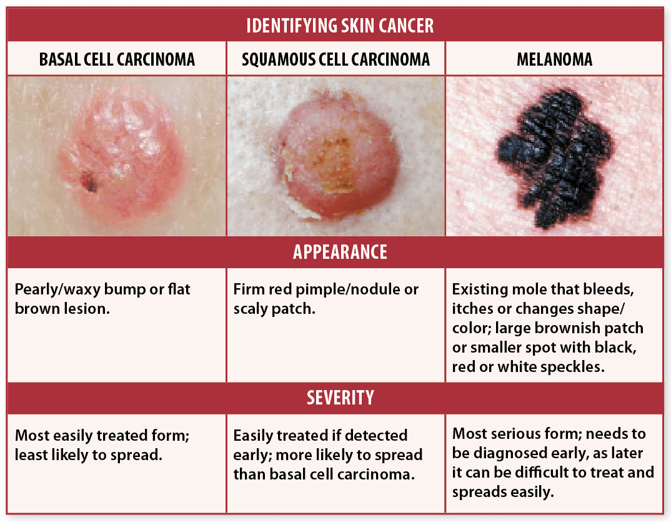
Topics Considered
Focus: Skin cancer - too broad
Choose one of the three skin cancer types to focus machine learning
Decision: Focus on melanoma because it is the deadliest and is harder to distinguish than SCC and BCC.
Figure 1: three skin cancer types
Adapted from: https://psderm.com/skin-cancer/
Notes:
Dani
Photo fro https://psderm.com/skin-cancer/
Admin, D. L. M. (2019). Identifying Skin Cancer. PS Derm. photograph. Retrieved from https://psderm.com/skin-cancer/.

Slide 4
Topic of choice: Implementation of Machine Learning to detect Melanoma Skin Cancer
The application of machine learning algorithms to the detection of melanoma skin cancer has the potential to revolutionize the methods now used to diagnose and treat this potentially lethal illness. Melanoma is a type of skin cancer that develops in the cells known as melanocytes, which are responsible for the production of color in the skin. Melanoma has the potential to rapidly spread and become fatal if it is not detected.
Approaches based on machine learning have shown promise for making melanoma diagnoses more accurate and faster, which is important for effective treatment.
(Han et al., 2018)

Slide 5
Topic of choice: Implementation of Machine Learning to detect Melanoma Skin Cancer (cont.)
By analyzing photographs of skin lesions with machine learning algorithms, medical professionals, such as dermatologists and physicians, can rapidly identify possible cases of melanoma and take preventative measures before the disease progresses. (Han et al., 2018)
By increasing the precision and speed of melanoma detection, machine learning algorithms can help minimize the death rate associated with this fatal disease and eventually save lives (Takiddin et al., 2021).

Slide 6
Topic of choice: Implementation of Machine Learning to Detect Melanoma Skin Cancer
6th most prevalent cancer in the U.S. (Key Statistics, 2022)
One study found that a learning algorithm could reliably differentiate between melanoma and non-melanoma skin lesions with a sensitivity of 92.1% and a specificity of 91.1% (Haenssle et al, 2018).
Another study discovered that a deep learning algorithm could identify melanoma with 95% sensitivity and 91% specificity, outperforming human dermatologists in the same job (Han et al, 2018).

Slide 7

Melanoma Diagnosis
Physical exam (through a spot check or full body skin check) -usually by a dermatologist
Provider will likely use a dermatoscope for closer look at moles
Mole appears suspicious to provider -> shave biopsy
Lab examination by pathologist
(Mayo Clinic, 2022)
Notes:
Dani

Slide 8
Proposed solution
Skin scanner
Total body photography/Sequential digital dermoscopic imaging.
Self-detection tool, affordable, can be used at home.
Alert system -> abnormal moles with melanoma like structure.
Provides information about local board certified dermatologists.
(Afifi et al., 2020)
Notes:
Anh

Slide 9
How we brainstormed
Blackboard
Collaborate
WhatsApp
At the end of some classes
Group chat
Group calls

Slide 10
References
Admin, D. L. M. (2019). Identifying Skin Cancer. PS Derm. photograph. Retrieved from https://psderm.com/skin-cancer/
Afifi, L., Cortez, J., Johal, A., Nosrati, A., Tam, A., Vora, N. B., Wei, M. L., Wong, A., Yan D., Yeniay, Y. & Young, A. T. (2020, June 18). The role of technology in melanoma screening and diagnosis. Wiley Online Library. https://onlinelibrary.wiley.com/doi/full/10.1111/pcmr.12907
Haenssle, H. A., Fink, C., Schneiderbauer, R., Toberer, F., Buhl, T., Blum, A., Kalloo, A., Hassen, A. B. H., Thomas, L., Enk, A., Uhlmann, L., Reader study level-I and level-II Groups, Alt, C., Arenbergerova, M., Bakos, R., Baltzer, A., Bertlich, I., Blum, A., Bokor-Billmann, T., Bowling, J., … Zalaudek, I. (2018). Man against machine: diagnostic performance of a deep learning convolutional neural network for dermoscopic melanoma recognition in comparison to 58 dermatologists. Annals of oncology: Official journal of the European Society for Medical Oncology, 29(8), 1836–1842. https://doi.org/10.1093/annonc/mdy166
Han, S. S., Kim, M. S., Lim, W., Park, G. H., Park, I., & Chang, S. E. (2018). Classification of the Clinical Images for Benign and Malignant Cutaneous Tumors Using a Deep Learning Algorithm. The Journal of investigative dermatology, 138(7), 1529–1538. https://doi.org/10.1016/j.jid.2018.01.028
Key Statistics For Melanoma Skin Cancer. American Cancer Society. (2023, January 12). Retrieved March 14, 2023, from https://www.cancer.org/cancer/melanoma-skin-cancer/about/key-statistics.html
Mayo Clinic (2022, June 18). Melanoma. https://www.mayoclinic.org/diseases-conditions/melanoma/diagnosis-treatment/drc-20374888
Takiddin, A., Schneider, J., Yang, Y., Abd-Alrazaq, A., & Househ, M. (2021, November 24). Artificial Intelligence for Skin Cancer Detection: Scoping Review. PubMed Central (PMC). https://doi.org/10.2196/22934

Slide 11


